Slide 1

Theme: LoRa Based IoT
Batch No: 6
Project Title: LORA BASED EFFICIENT CROP MONITORING SYSTEM
Guided By: Mr. K. MANIKANDAN, M.E.
SHANTOSH N
MOHAMMED THAJUDEEN R
KAVICHOZHAN K
VASANTH S

Slide 2
Contents
Abstract
Problem Statement
Existing System
Proposed System
Block Diagram
Working Principle
Components
Advantages
Output
Conclusion

Slide 3
Abstract
The agricultural sector is undergoing a transformation driven by advancements in technology, with the aim of enhancing productivity, reducing resource wastage, and ensuring sustainable practices.
The system utilizes LoRa technology to establish a low-power, long-range wireless network infrastructure, facilitating seamless communication between farms and farmers.
By harnessing the power of LoRa technology, the system ensures efficient resource utilization while minimizing manual intervention.

Slide 4

Problem statement
Micro and small scale farmers in agriculture encounter various challenges that hinder their productivity and profitability.
These challenges include limited access to resources, lack of technical knowledge, unpredictable weather conditions, and inefficient water management practices.

Slide 5
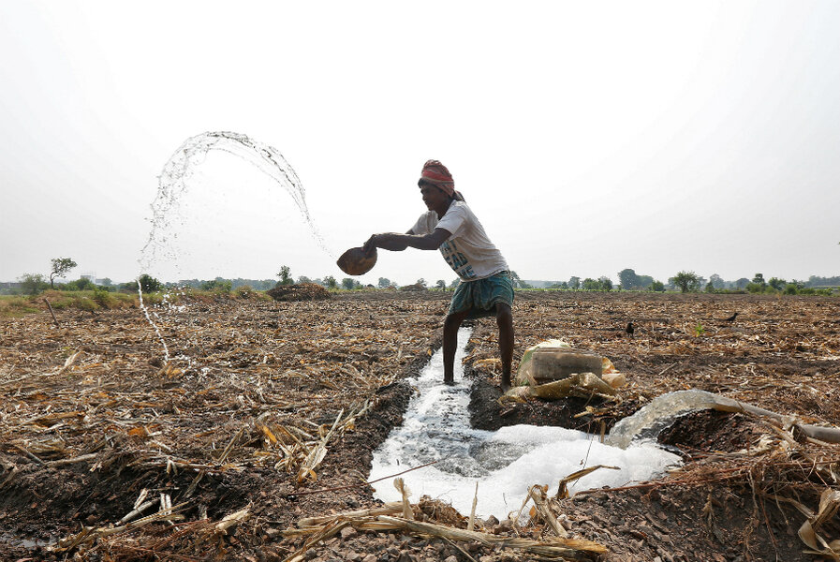
Existing System
Traditional agricultural practices depends on manual labor and periodic observation by farmers to monitor and manage crop conditions.
Irrigation scheduling, a critical aspect of farm management, is often based on intuition rather than data-driven decision-making, resulting in
over- or under-watering of crops.

Slide 6
Proposed System
In our proposed system, we integrated a circuit with LoRa in agricultural land, where farmers can access the farms within a range of 10km.
Farmers can virtually connect to farm via mobile and access real time data.
With the help of sensors, farmers observe the moisture, temperature of their farms.
The system integrates motor control mechanisms that enable virtual irrigation based on climatic condition and farmer preferences.

Slide 7
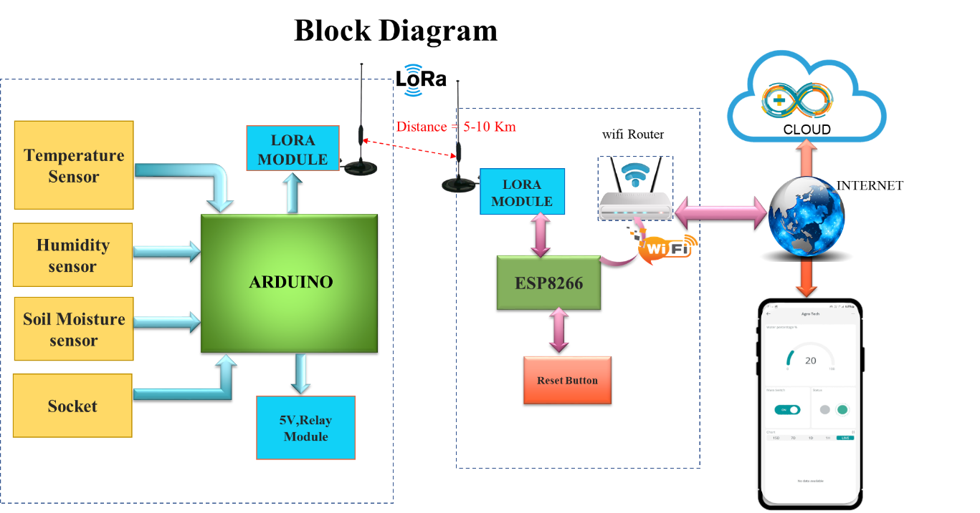

Slide 8
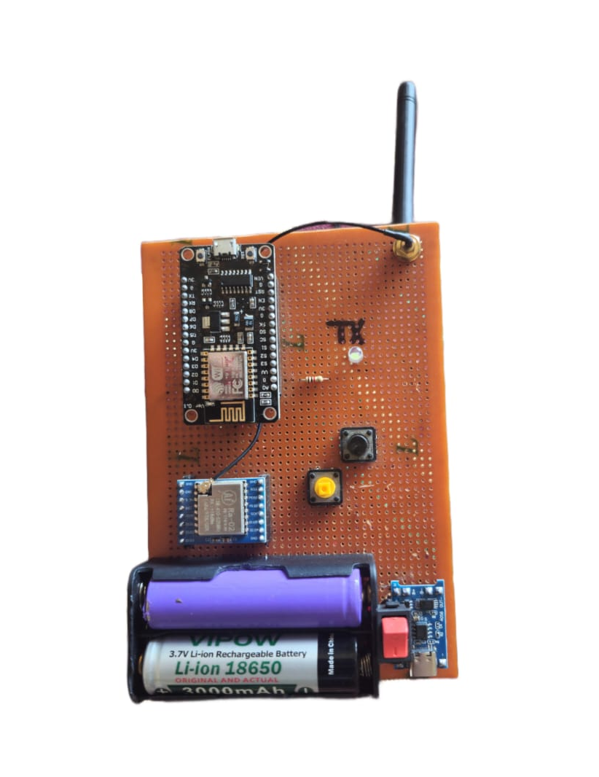
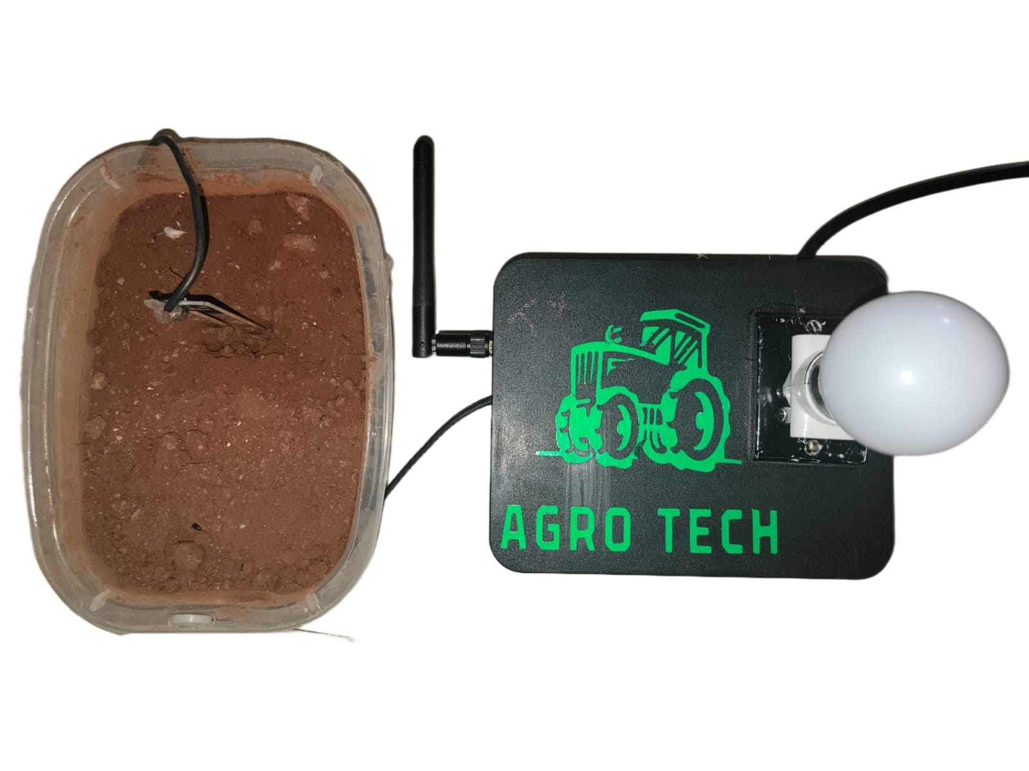
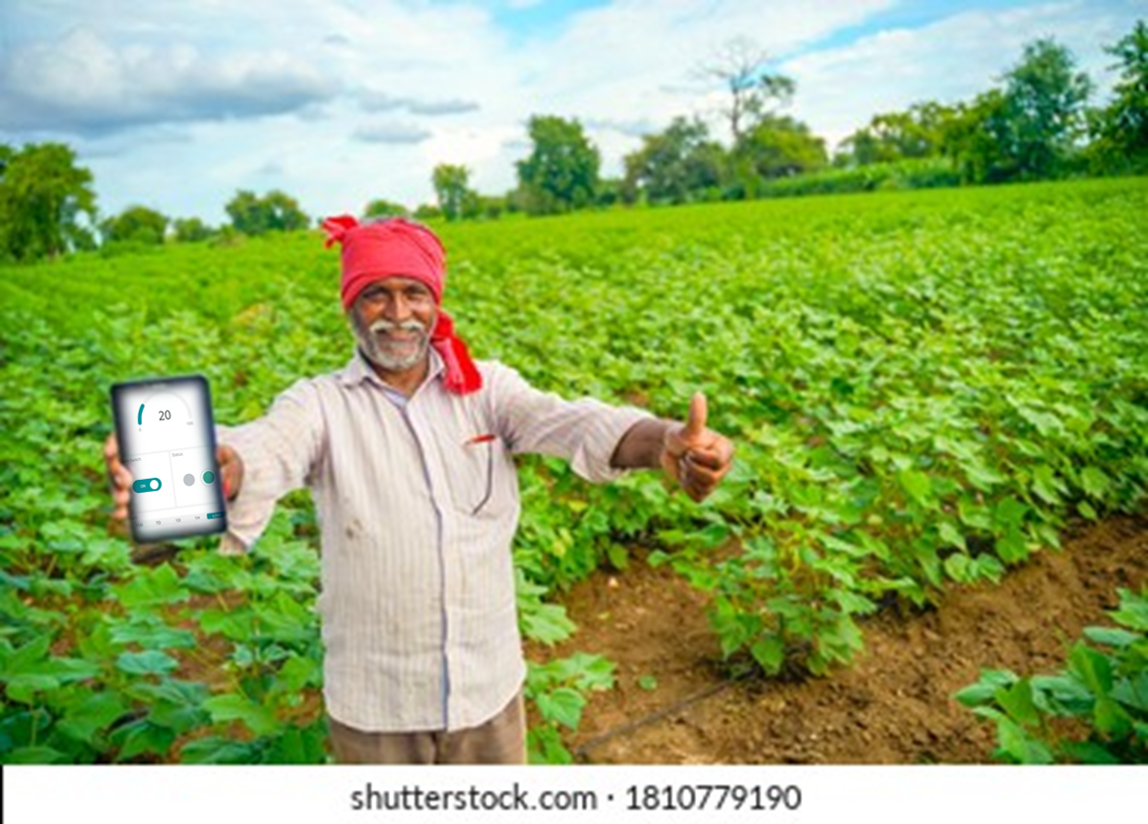
Hardware Prototype

Slide 9
Working Principle
Sensor nodes are deployed across the farm.
They collect data on environmental parameters crucial for crop growth and health.
Communication between sensor nodes and a central gateway is wireless, using the LoRa (Long Range) protocol.
Farmers can access real-time farm data and control functions through a user-friendly interface.
The interface is accessible via web or mobile applications.

Slide 10
Working Principle
Remote monitoring allows farmers to observe environmental conditions.
They can modify irrigation schedules or activate motor control mechanisms remotely.
The system operates continuously, offering real-time updates on crop conditions and environmental parameters.
With this information, farmers can make informed decisions to optimize farm operations.

Slide 11
Components
LoRa Ra-02 SX1278
Arduino Nano
Esp8266
Charging module
Antenna
Battery
LED
Relay

Slide 12
Advantages
Remote Monitoring
Enhanced Crop Yields
Reduced Labour Costs
Scalability and Flexibility
Sustainability
Enhanced Decision-Making
Weather station in our farm
Reduced Environmental Impact

Slide 13
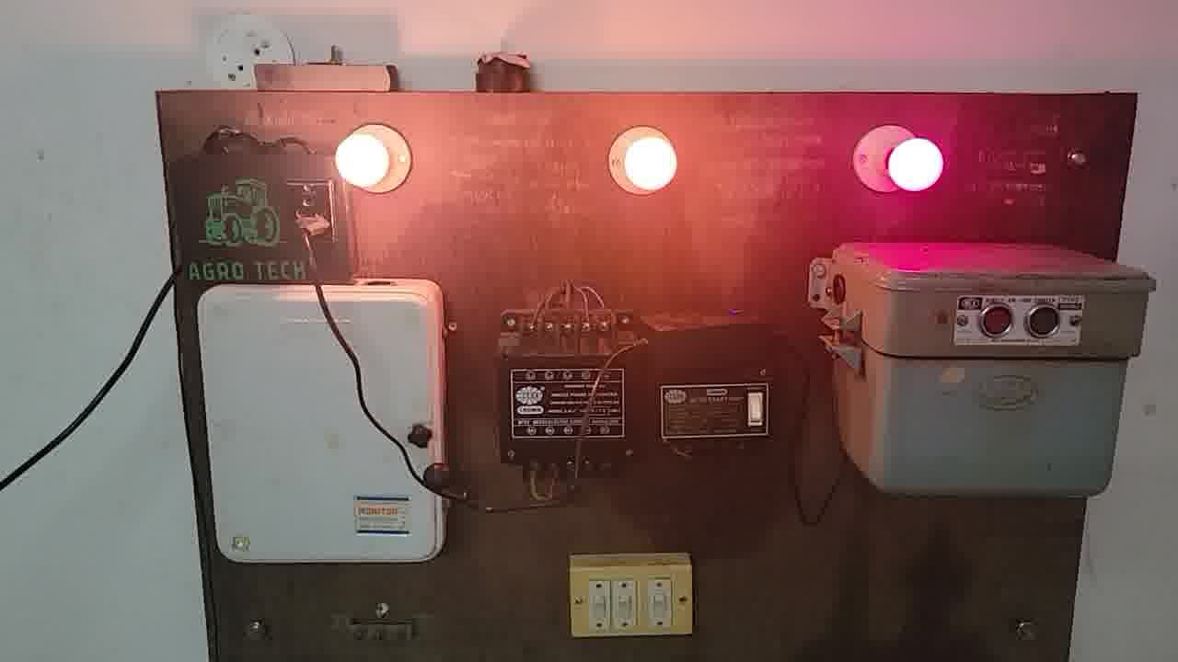
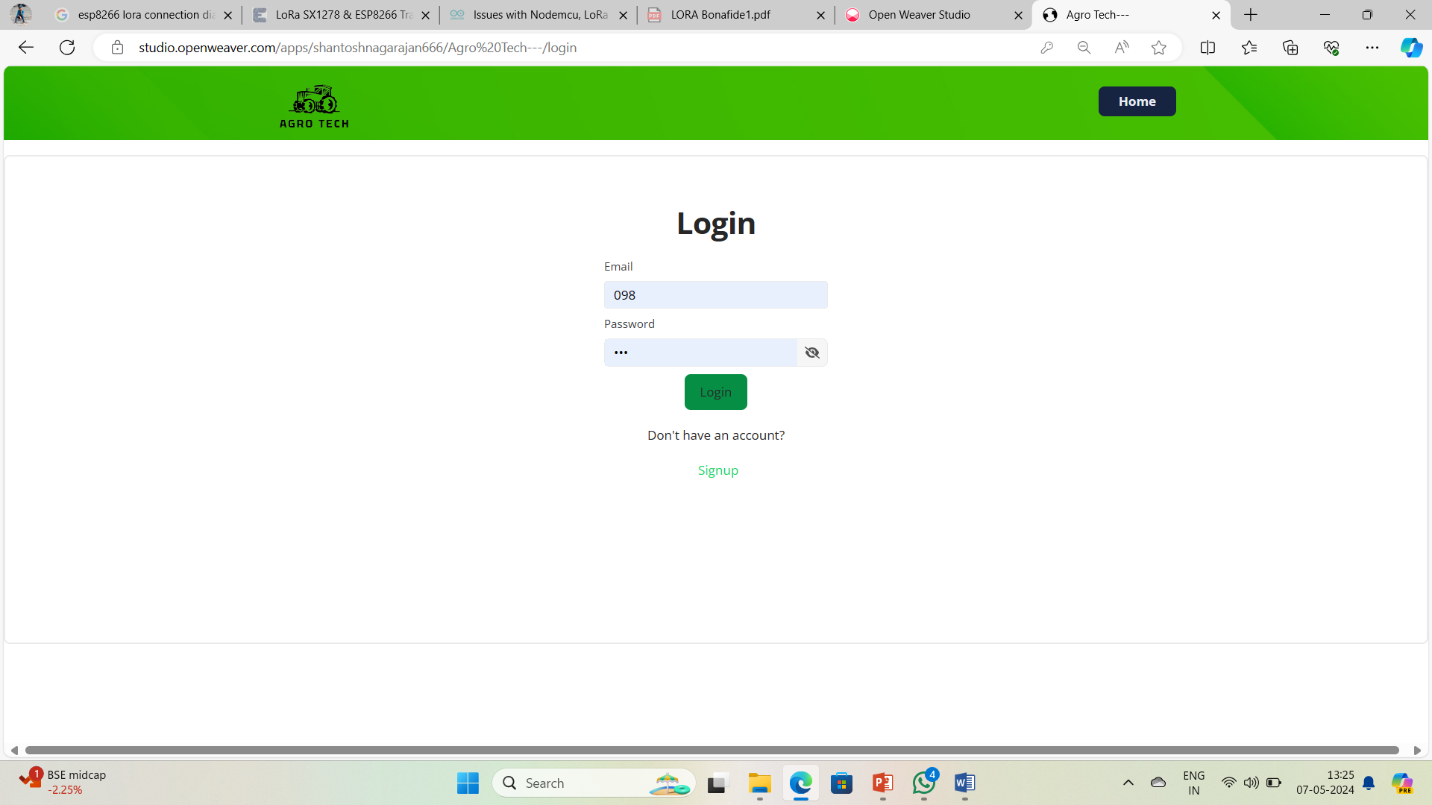
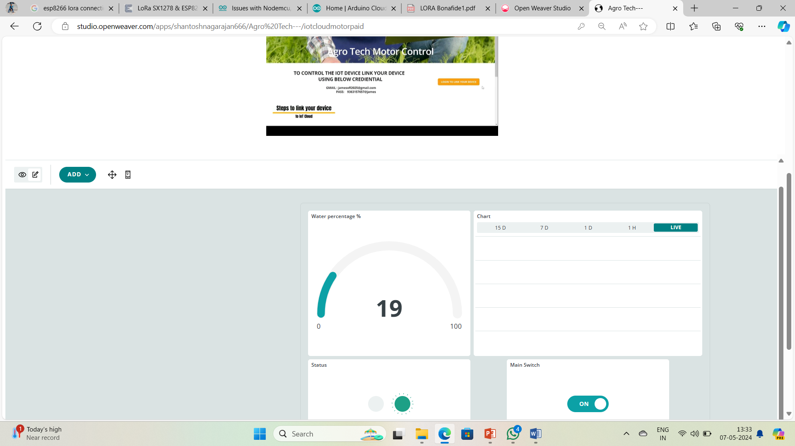
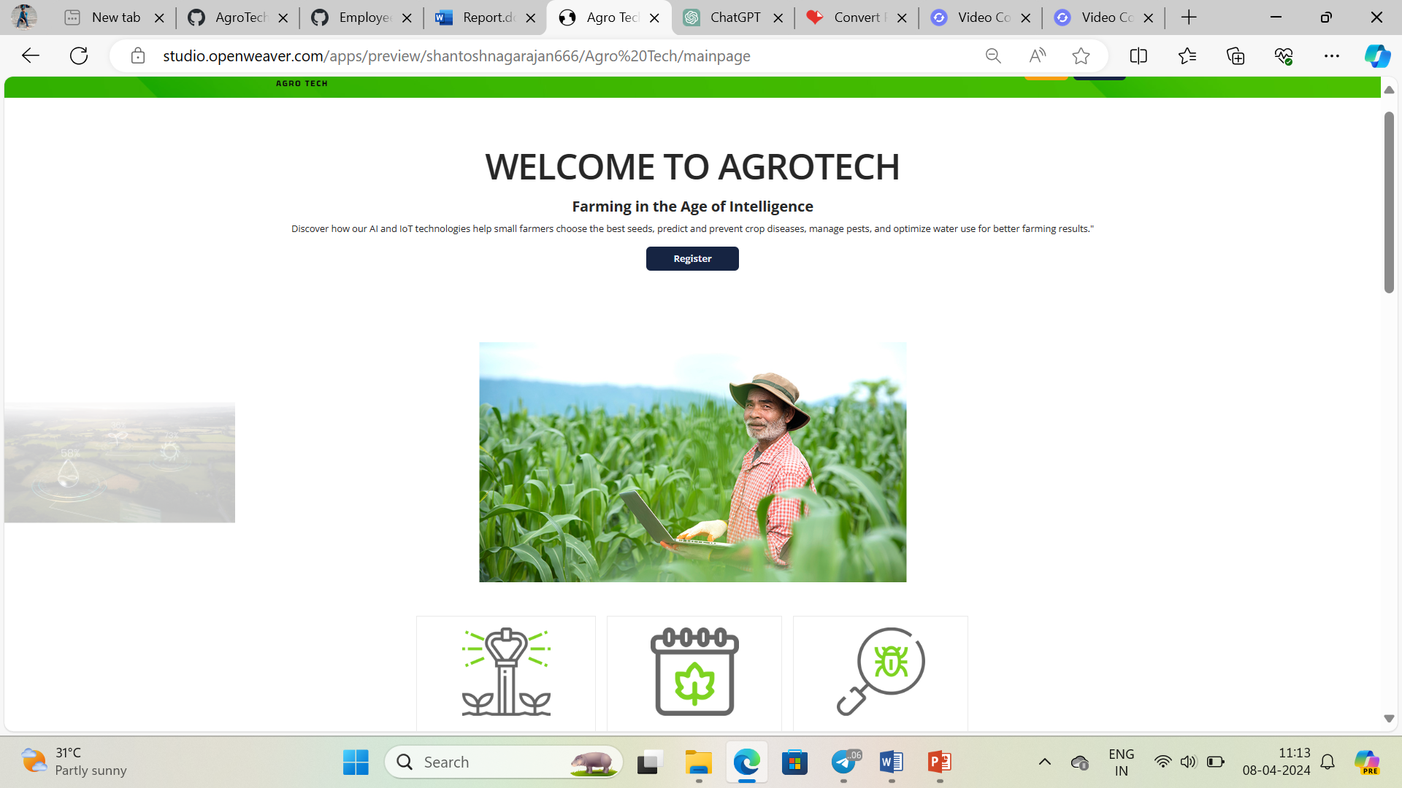
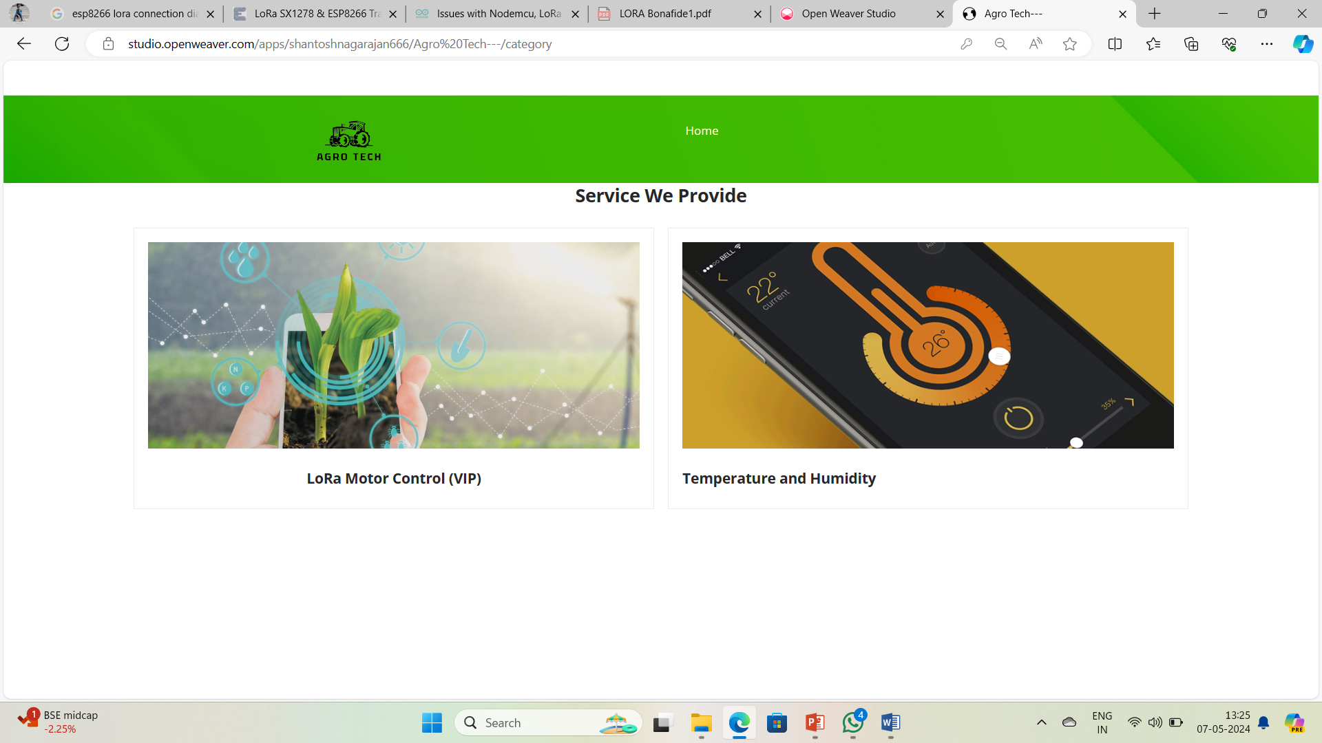
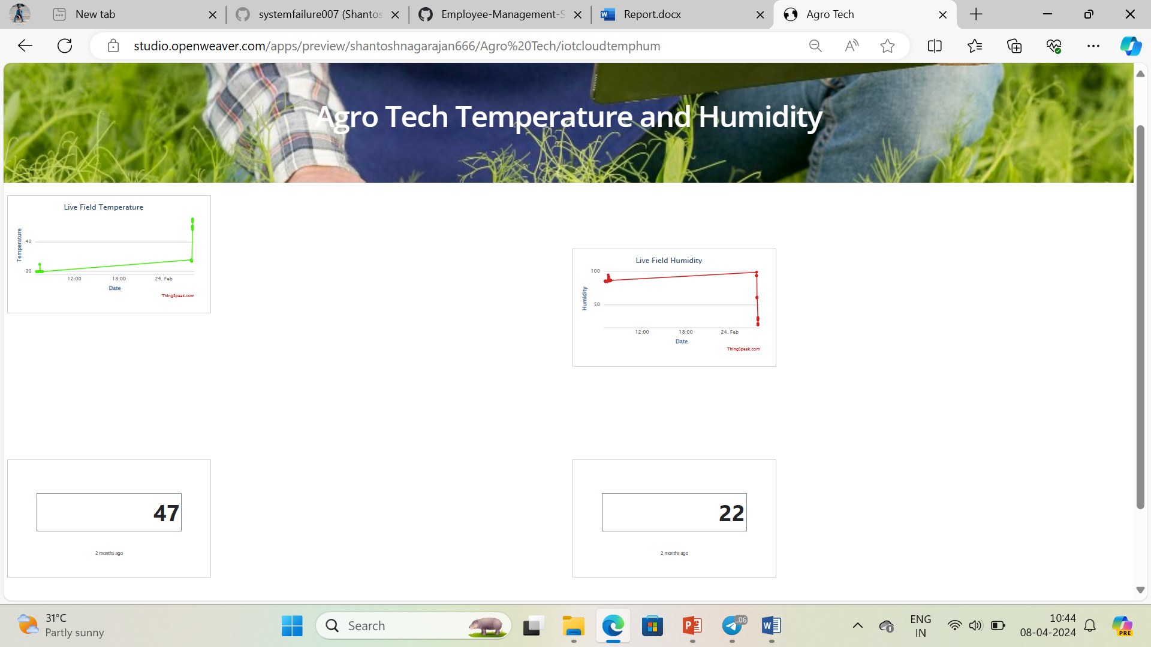
Output

Slide 14
Conclusion
In essence, the proposed LoRa-based smart agriculture system represents a significant step towards the realization of a more connected, intelligent, and sustainable future for agriculture.
By embracing innovation and leveraging the power of data and connectivity, farmers can optimize their operations, mitigate risks, and contribute to global food security while safeguarding natural resources and ecosystems for future generations.

Slide 15
References
[1]G. S. Nagaraja, A. B. Soppimath, T. Soumya and A. Abhinith, "IoT based smart agriculture management system", Proc. 4th Int. Conf. Comput. Syst. Inf. Technol. Sustain. Solution (CSITSS), pp. 1-5, Dec. 2019.
[2]E. Siddhartha and M. C. Lakkannavar, "Smart irrigation and crop health prediction", Proc. Int. Conf. Recent Trends Electron. Inf. Commun. Technol. (RTEICT), pp. 739-742, Aug. 2021.
[3]K. Parasuraman, U. Anandan and A. Anbarasan, "IoT based smart agriculture automation in artificial intelligence", Proc. 3rd Int. Conf. Intell. Commun. Technol. Virtual Mobile Netw. (ICICV), pp. 420-427, Feb. 2021.

Slide 16



